Slide 1
Project 2 – AIS
By Jan Pinto Strohhäusl
Notes:
Hello and welcome to this presentation
Name is jan pinto strohhäusl, im from group 2
Presentation is about what our group has done so far in this project

Slide 2
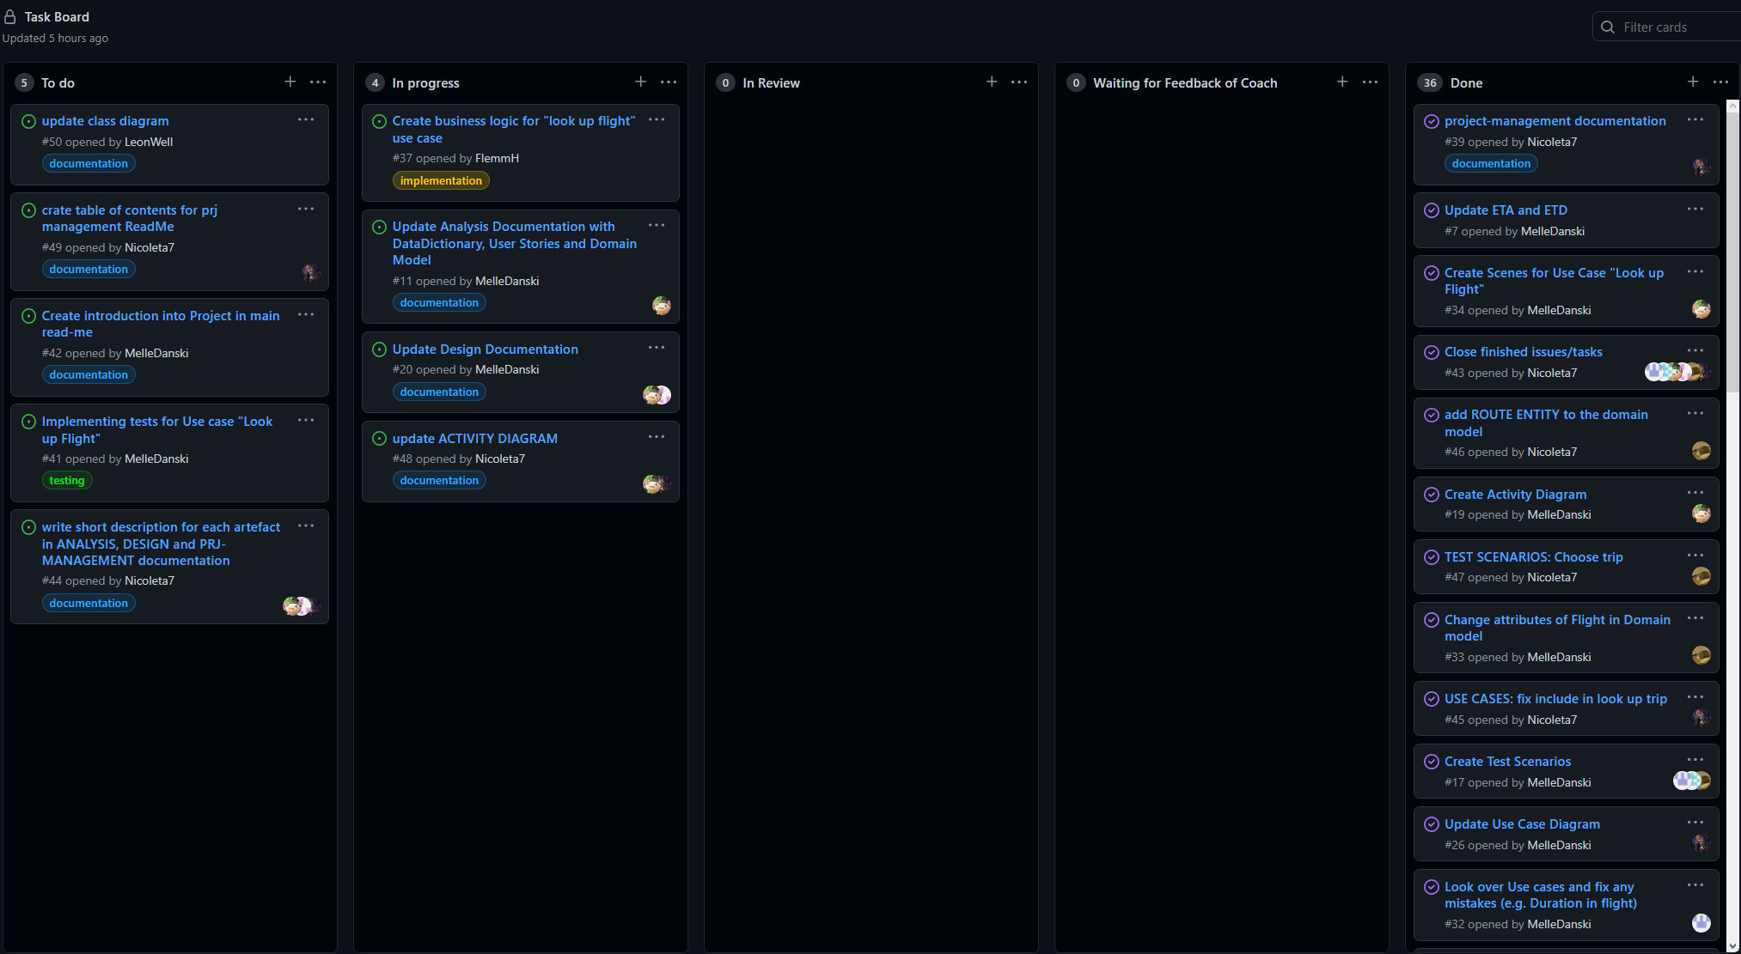
Project Management
Agile approach
Scrum
Pair Programming
Notes:
First start with project management
Agile approach with scrum
Sprint for 2 – 3 weeks for the tasks
Meeting every week to discuss what is done and what is still left
Pair programming, so we can program more efficient
Created management dashboard, helped us to divide tasks

Slide 3
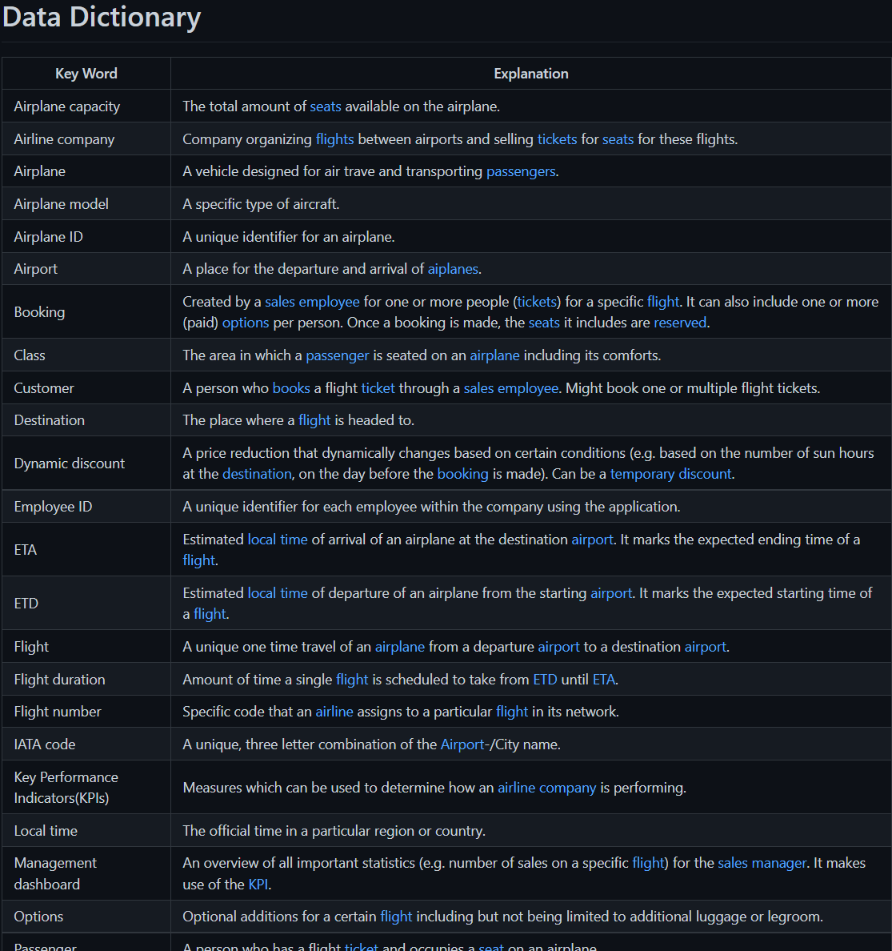
Analysis – Data Related Artefacts
Notes:
Lets switch to the analysis artefacts
Now first artefact
Created Data dictionary
Definition for every entity we are using

Slide 4
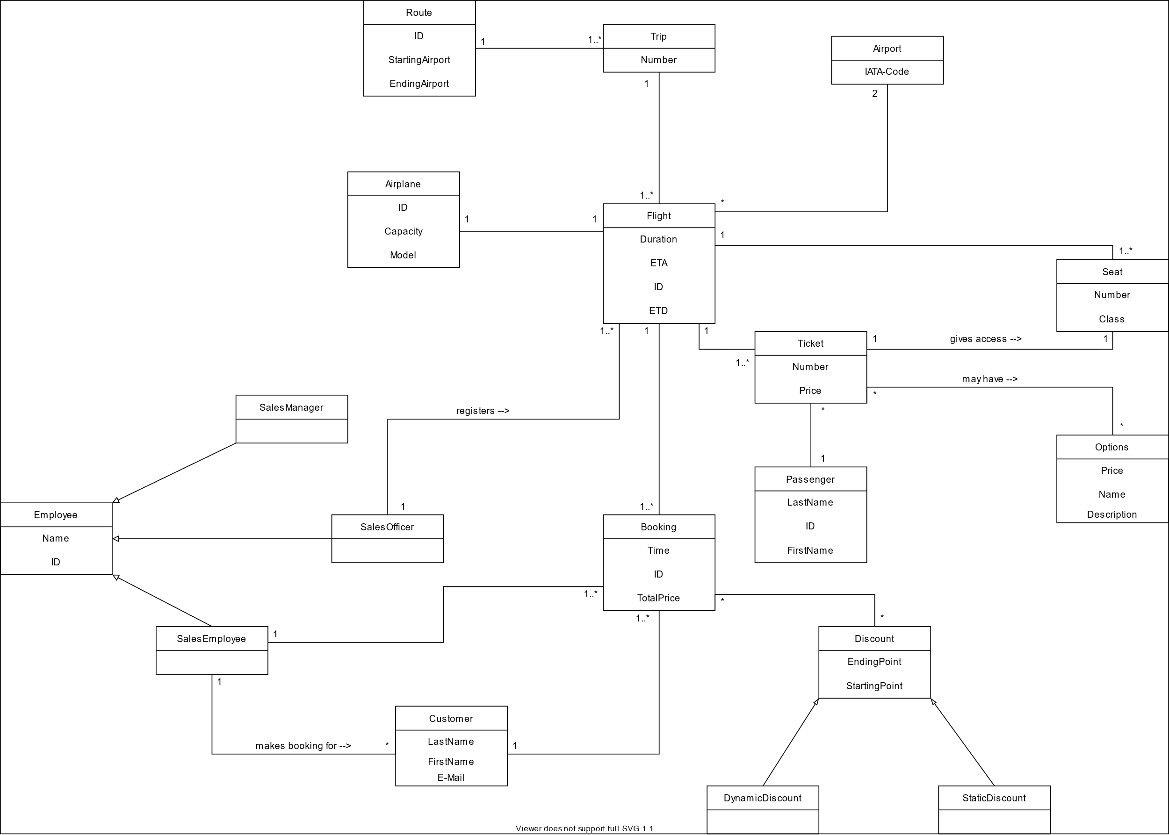
Notes:
Domain model
Relations between entities
All entries from data dictionary as entity or attribute

Slide 5
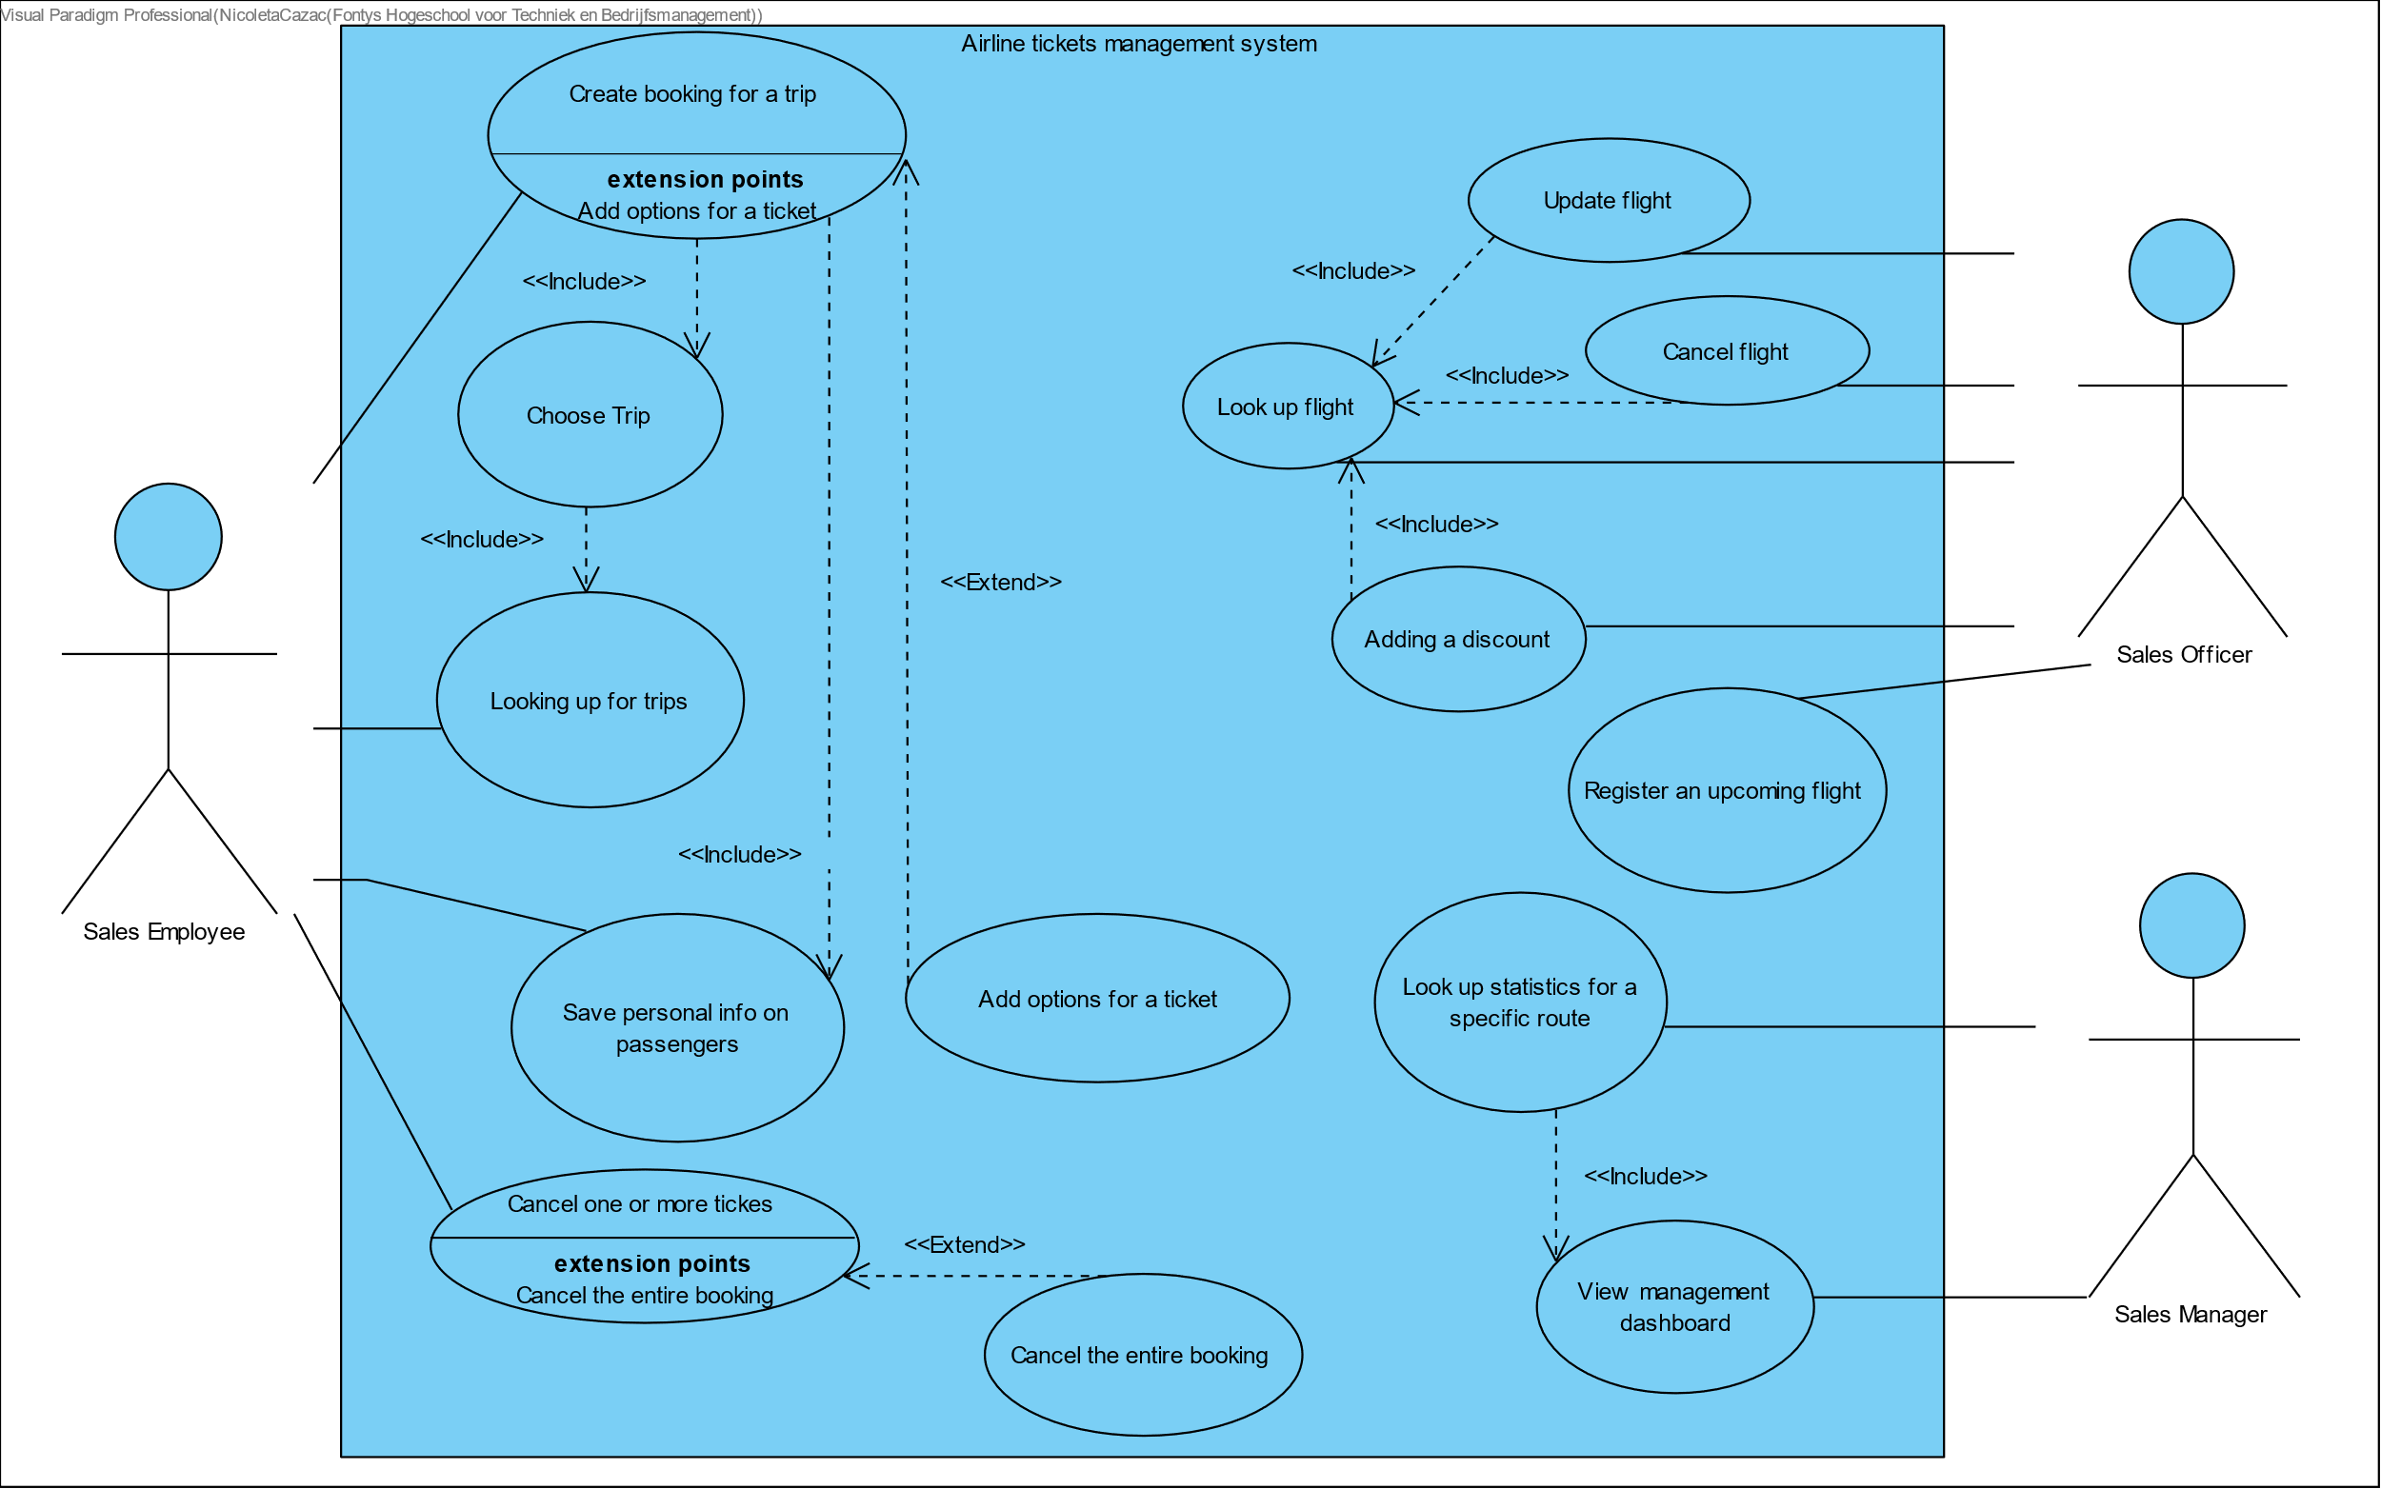
Analysis – User Related Artefacts
Notes:
Three user groups: sales employee, sales officer and sales manager
Employee: responsible for booking, creating, cancelling, interacting with customers on phone
Officer: handling flights, create, update, cancel
Manager: statistics
Use cases in this use case diagram we created showing these divisions

Slide 6
Analysis – User Related Artefacts
Test Scenario: Looking up flight
Use Case: Looking up flight
1. Actor indicates he wants to look up a specific flight
2. System asks for a unique flight ID
3. Actor provides the information asked for
4. System displays the flight and all information regarding the flight
1. Actor (#30) indicates he wants to look up a flight
2. System asks for the flight ID
3. Actor provides the flight ID: FA123
4. System displays the flight FA123 and all information regarding the flight
Notes:
Use case look up flight, cause implemented it
2. system asks for the fligh id which is belonging to the flight
Test scenario with specific id for actor and flight

Slide 7
Analysis – User Related Artefacts
Test Scenario Exception: flight does not exist
Use Case Exception: flight does not exist
1. Actor (#56) indicates he wants to look up a flight
2. System asks for the flight ID
3. Actor provides the flight ID: UIS23
4. System displays that the flight was not found
1. Actor indicates he wants to look up a specific flight
2. System asks for a unique flight ID
3. Actor provides the information asked for
4. System informs actor about unavailability of the flight for the inputted flight ID
4.1 Return to step 2
Notes:
Also have exception: flight doesnt exist
Return to step 2
Also with test scenario

Slide 8
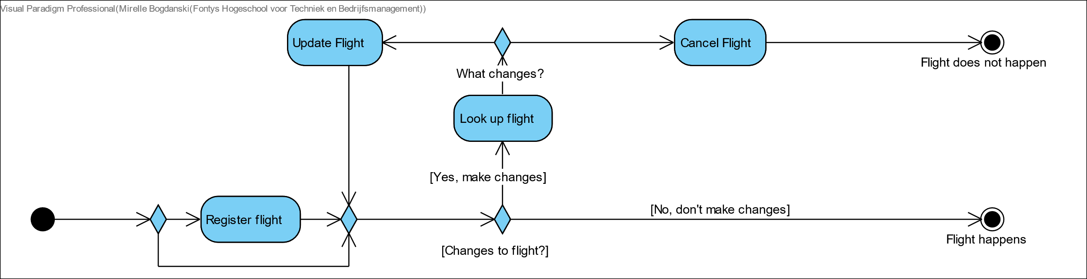
Analysis – Task Related Artefacts
Activity Diagram: Manage Flights Process
Notes:
Created many activity diagrams
One is manage flights
*activity diagram vorstellen*

Slide 9
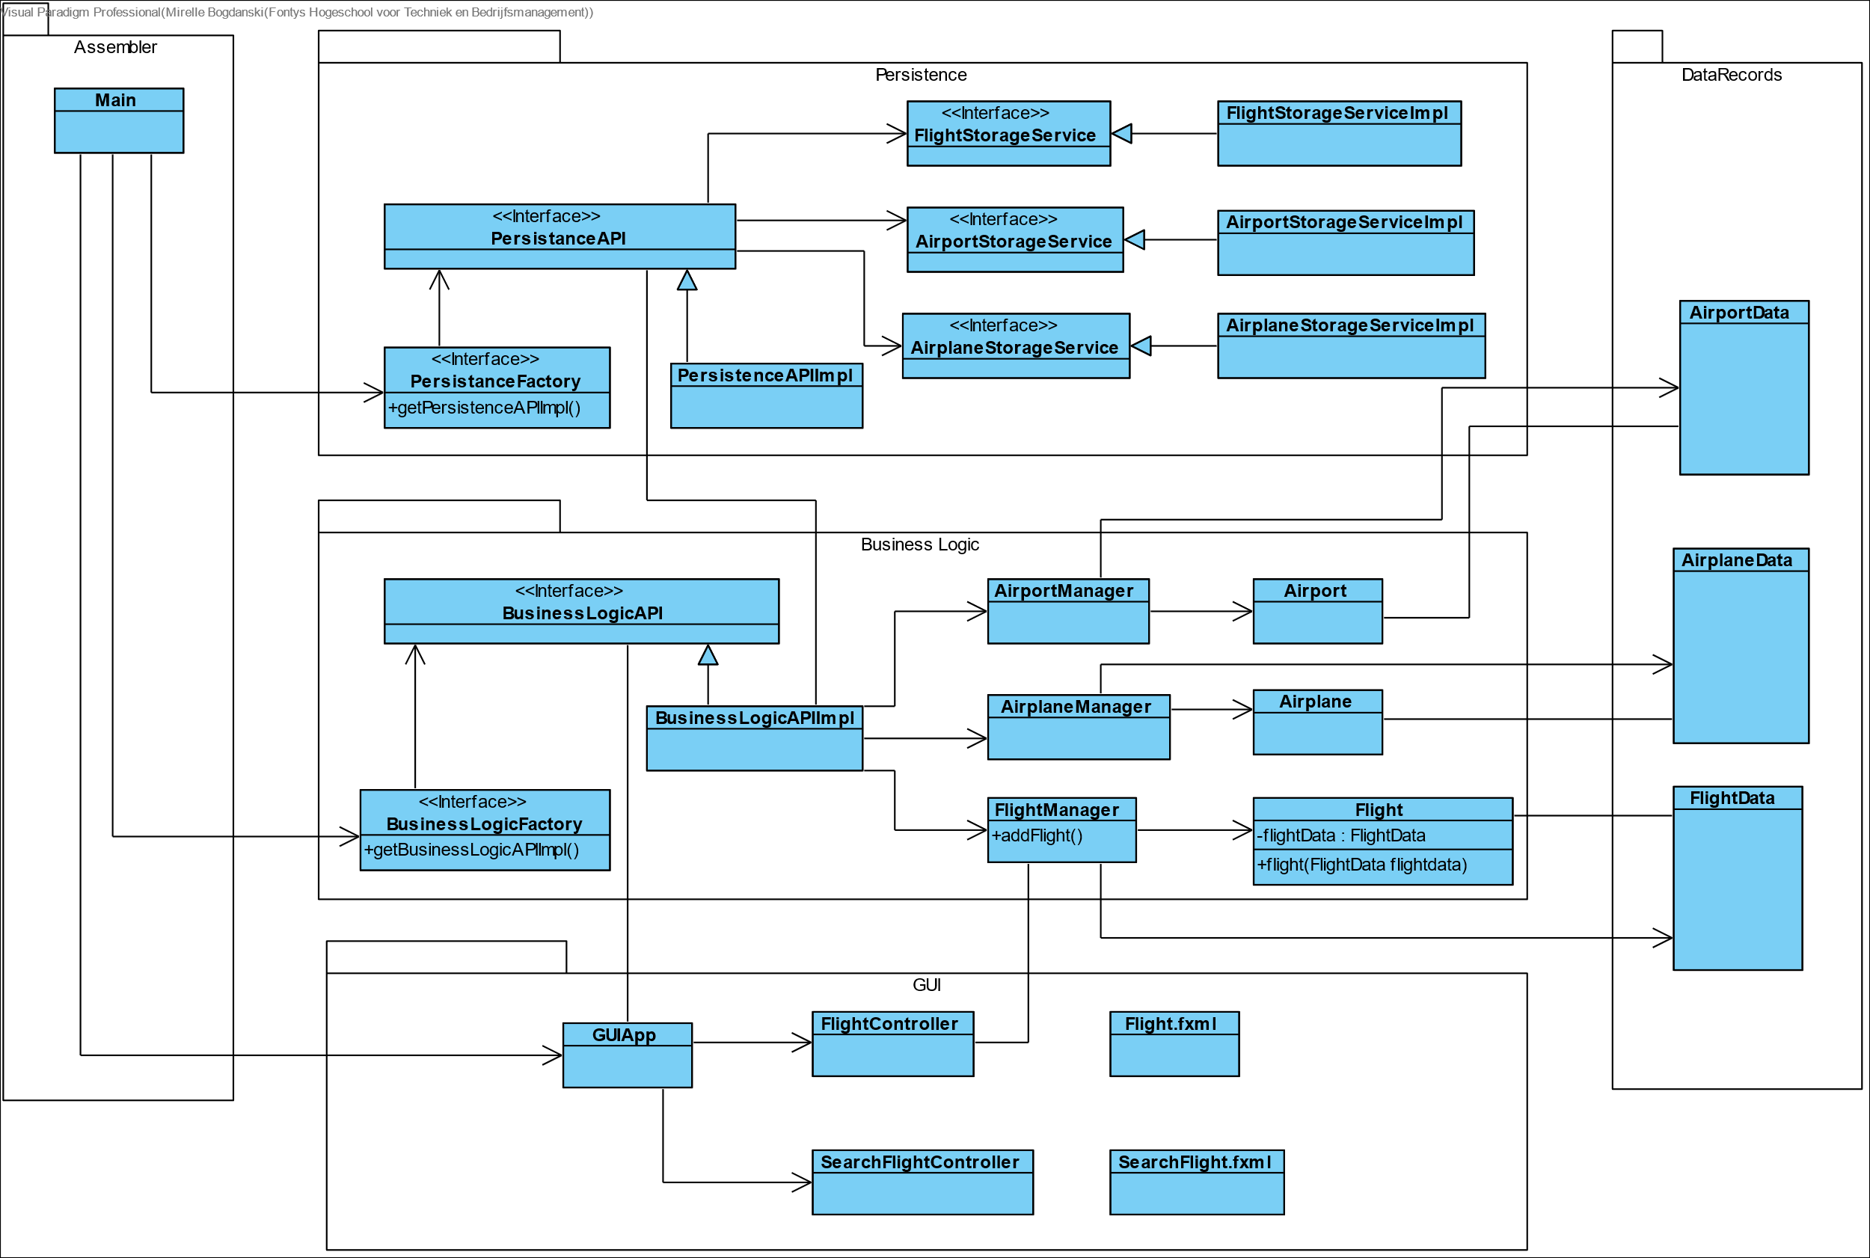
Design – Class Diagram
Notes:
Last one design: class diagram for implementation
See all classes and interfaces in different layers
*wenn zu wenig zeit: erkläre die verschiedenen layers*
Need to update gui because we changed the gui

Slide 10
Thank you for your attention!
Any Questions?
Notes:
This was it
Thank you for your attention
Looking forward to answer your questions

